Slide 1
Big Data Technology Final Project Rest API + Kafka + Spark Streaming + Hive + Power BI
Source code:https://github.com/ngocbaosp/BDT/tree/master/FinalProject
Readme: https://github.com/ngocbaosp/BDT/blob/master/README.md
Advisor
Prof. Mrudula Mukadam
Member
NGOC BAO TRAN

Slide 2
Outline
Application Flow
Technologies
Demonstration
Q & A

Slide 3
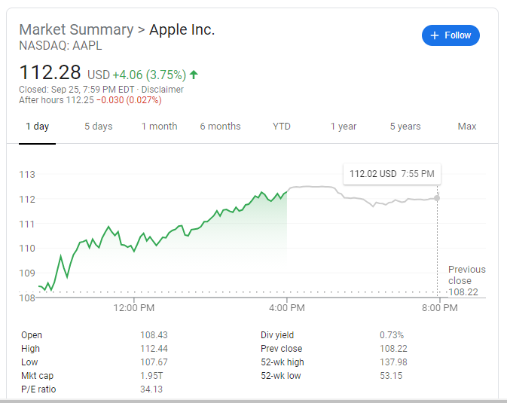
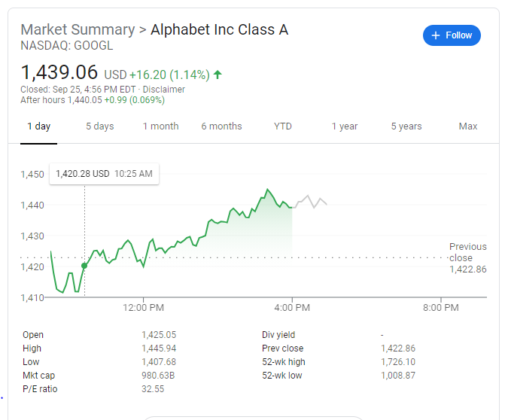
About Project
Suppose we want to analyze the stock data in real-time →
In this project we will do data streaming from the real-time cloud API (using IEX Cloud Service https://iexcloud.io)

Slide 4
Application Flow
Realtime Web API Data source
(https://iexcloud.io)
Kafka Producer
Kafka Topic
Spark Streaming + Kafka
HDFS
Hive
Create report using Power PI
Power BI Report
Publish Report
to Web Power BI
Report/Chart

Slide 5
Technologies
Data source
Web Restful API (Financial data and services)
https://iexcloud.io
Producer
Apache Kafka
Streaming
Spark Streaming Kafka
Consumer
Apache Kafka
Data Storage
Hive
Reporting & Analysis Tools
Power BI
Excel
https://kafka.apache.org/
https://kafka.apache.org/
https://spark.apache.org/
https://hive.apache.org/
Environments
Cloudera (VM Quick start)

Slide 6
Demo – Kafka+SparkStreaming
https://sandbox.iexapis.com/stable/stock/AAPL/quote?token=Tsk_2ec682f2ca234a04bb108023943ea5e8
IEX Cloud
Rest API
Kafka Producer
(Apple stock prices)
SparkStreaming
Kafka Topic
(Apple Data)
https://sandbox.iexapis.com/stable/stock/GOOGL/quote?token=Tsk_2ec682f2ca234a04bb108023943ea5e8
IEX Cloud
Rest API
Kafka Producer
(Google stock prices)
Kafka Topic
(Google Data)
SparkStreaming
HDFS
Hive table
Create & Publish report using Power BI
https://sandbox.iexapis.com/stable/stock/MSFT/quote?token=Tsk_2ec682f2ca234a04bb108023943ea5e8
IEX Cloud
Rest API
Kafka Producer
(Microsoft stock prices)
Kafka Topic
(Microsoft Data)
SparkStreaming
Report/Chart

Slide 7
Demo – Kafka+SparkStreaming
Step 1: Create Kafka topic: 3 topics
One for Apple stock, one for Google stock and one for Microsoft stock
Step 2: Run Spark Streaming app
one for Apple stock and one for Google stock
Step 3: Run Kafka Producer
one for Apple stock and one for Google stock
Step 4: Check data in HDFS
Step 5: Create Hive table, create partitions (based on symbol), select data from Hive table
Step 6: Create report, chart using Power BI connects to Hive, then publish report to Web Power BI
Step 7: Run Spark Streaming app for Microsoft stock
Step 8: Run Kafka Producer app for Microsoft stock
Step 9: Refresh PowerBI report, verify data and republish report (will see Microsoft data added)
Step 10: Refresh report on Web PowerBI and verify data (will see Microsoft data added)

Slide 8
Demo – Kafka Producer & Consumer
https://sandbox.iexapis.com/stable/stock/AAPL/quote?token=Tsk_2ec682f2ca234a04bb108023943ea5e8
IEX Cloud
Rest API
Kafka Producer
(Apple stock prices)
Kafka Topic
Kafka Consumer
Console log
https://sandbox.iexapis.com/stable/stock/GOOGL/quote?token=Tsk_2ec682f2ca234a04bb108023943ea5e8
IEX Cloud
Rest API
Kafka Producer
(Google stock prices)
Notes: Using Kafka we can create any flows as below
+ one producer – one topic - one consumer
+ multiple producers – one topic - one consumer
+ multiple producers – one topic - multiple consumers
+ multiple producers – multiple topics - multiple consumers

Slide 9
Demo – Kafka Producer & Consumer (cont)
Step 1: Create Kafka topic
Step 2: Run consumer app
Step 3: Run producer app
kafka-topics --zookeeper quickstart.cloudera:2181 --create --topic demoTopic --partitions 1 --replication-factor 1
java -jar '/home/cloudera/workspace/FinalProject/RunnableJarFiles/consumer.jar’ demoTopic
java -jar '/home/cloudera/workspace/FinalProject/RunnableJarFiles/producer.jar' demoTopic AAPL 5
java -jar '/home/cloudera/workspace/FinalProject/RunnableJarFiles/producer.jar' demoTopic GOOGL 5

Slide 10
Thank you for your attention !!!

